Slide 1
Customer retention
A data analysis
by Utsav Rastogi

Slide 2
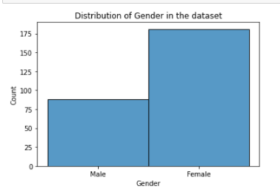
Gender of the customers
The analysis tells us that there was a large number of females among the customers, where males stood at only 88 females had a quantity of 181

Slide 3
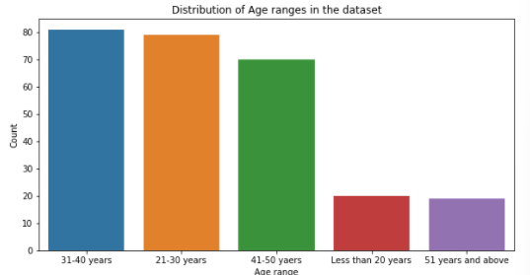
Age groups of the customers
We can infer from the graph above that the survey was mostly participated in by people between the age range of 21-50 years indicating that mostly youth and the working people participated in this survey..

Slide 4
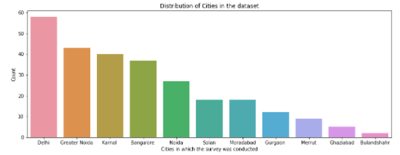
Cities of the customers
We can infer from the graph that all the cities are located in the northern India. Delhi NCR accounts for most of the customers whereas Bulandshahr accounts for the least amount of people who belonged to this city and did the survey

Slide 5
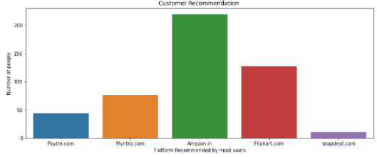
Platform most recommended
Amazon is highly recommended by almost all of them and snapdeal is recommended by only a handful and is the least among the group. This shows how amazon, a company which entered very late in the Indian market has totally devastated its competitors who were in India way before amazon.

Slide 6
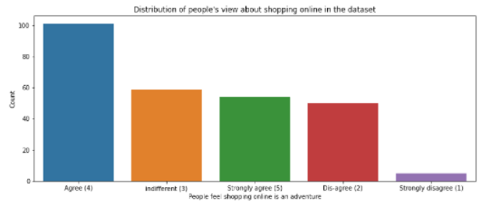
Customer’s opinion about online shopping
We can conclude from the above graph that more than half of the people feel adventurous when shopping online. They feel a rush internally which can be attributed to online shopping.

Slide 7
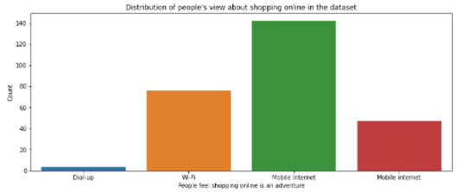
Customers access medium
We can see that most users access these websites through their mobile internet which indicates that all the ecommerce platforms are being accessed on mobile phones. Companies should spend more on developing their mobile interfaces.

Slide 8
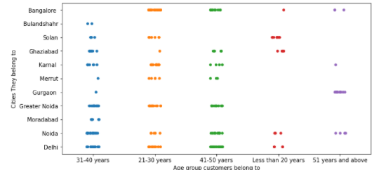
Cities vs age range of customers
We can conclude from the above that most cities lack users from the age range "Less than 20 years" and "51 years and above". We can also see that Delhi NCR has most of the younger ages as the participants. Bulandshahr lacks in almost each age range. From the graph, Solan looks like it has the most users who are below 20 years of age whereas Gurgaon is home to most participants with ages 51 and above . Delhi tops the age group of users in the range 41-50 years.

Slide 9
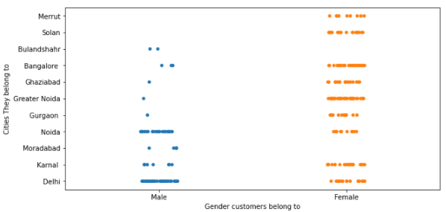
Gender vs Cities of the customers
We can infer that more participants in Delhi and Noida are males than females, whereas Greater Noida has the maximum number of females participants. Meerut and Solan do not have any male participants and Moradabad and Bulandshahr do not have any female participants.

Slide 10
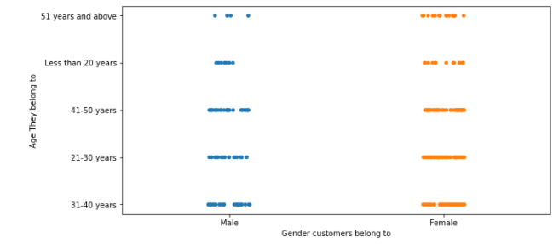
Gender vs age of customers
Most number of males belong to the 41 to 50 years of age group whereas females are major across a variety of age groups.

Slide 11
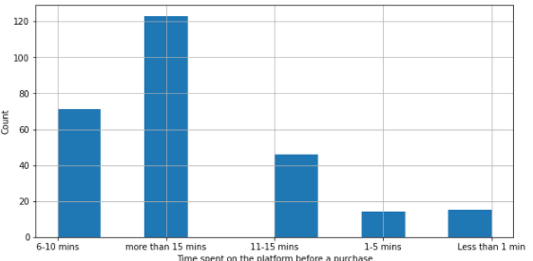
Time spent before each purchase
Resulting graph displays the logical outcome, as usually a customer will spend more than 15 mins to look for a product on the App or the website.

